Slide 1

BUSINESS ANALYTICS PROJECT
Customer Churn & Retention Analysis
A comprehensive data-driven investigation analyzing churn dynamics across 7,043 customer profiles to identify critical loss drivers and prioritize proactive retention intervention strategies.
Mohit Bhilala
IIT Kharagpur
MySQL • Power BI • Excel

Slide 2

Problem Statement & Objectives
The Business Challenge
Core Analytical Objectives
Customer churn reduces the active customer base and creates a need for targeted retention strategies in competitive telecom markets.
Deliver an end-to-end analytical framework to uncover high-impact churn drivers and enable targeted, data-backed operational decisions.
→
Difficulty pinpointing early indicators before subscription cancellation occurs.
→
Quantify baseline churn and retention metrics across 7,043 records.
→
Lack of consolidated visibility across contract terms, billing, and services.
→
Isolate multi-attribute churn risk profiles across 21 demographic and service factors.
→
Untargeted retention efforts may reduce the efficiency of retention spending.
→
Engineer interactive Power BI dashboards for ongoing executive risk mitigation.

Slide 3




Data & Analytical Workflow
2. SQL Analytics
Authored MySQL aggregations to extract cohort rates, tenure patterns, and multi-factor churn segments.
4. Strategy Deployment
Translated risk matrices into targeted retention playbooks and interactive executive dashboards.
1. Ingestion & Audit
3. BI Modeling
Processed 7,043 customer records across 21 columns; standardized missing values and charge formats.
Designed DAX measures, calculated groups, and interactive slicers inside Power BI Desktop.

Slide 4
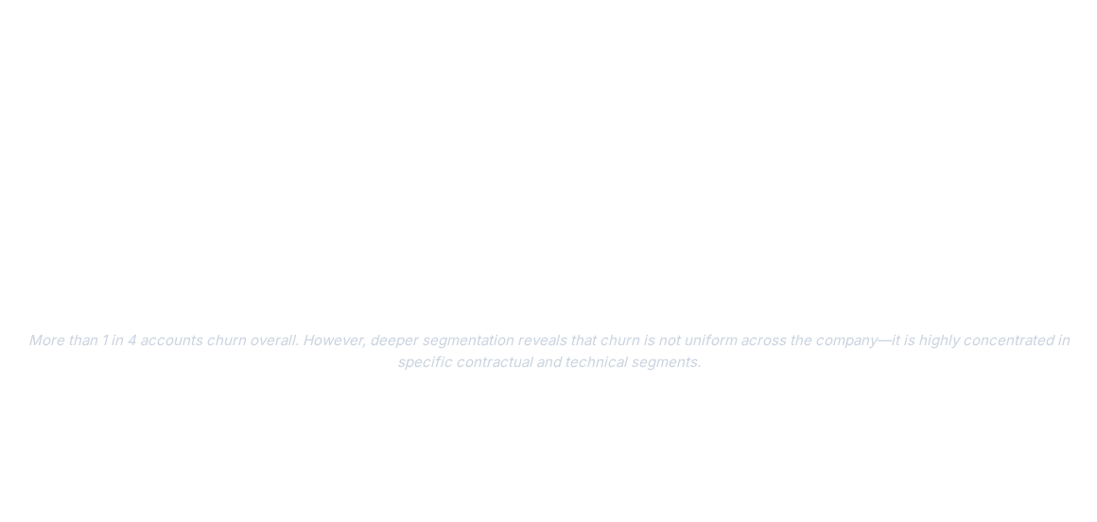

Overall Churn Performance
7,043
1,869
26.54%
73.46%
Total Customers
Churned Accounts
Overall Churn Rate
Retention Rate
Analyzed in complete dataset
Baseline benchmark metric
Sustained recurring customer base

Slide 5
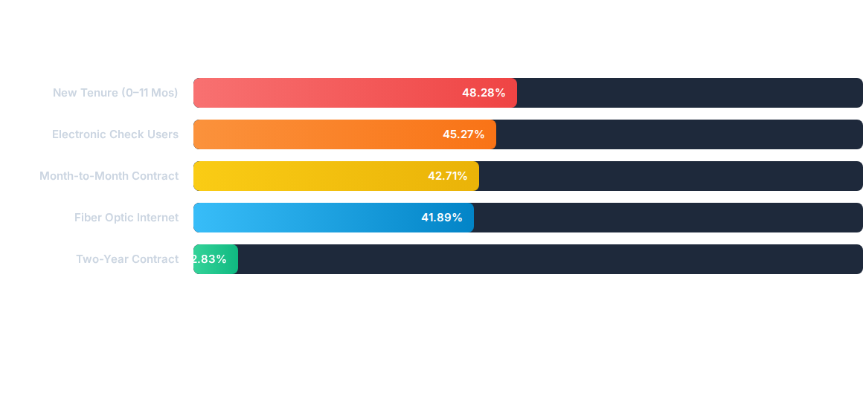
Key Churn Drivers Comparison
Tenure and contract duration emerge as important dimensions for customer-retention segmentation.

Slide 6














Churn Risk Matrix by Segment
Contract Type | DSL Service | Fiber Optic | No Internet | Total Churn Rate
Month-to-Month
One-Year
Two-Year
All Contracts Combined | 18.96% | 41.89% | 7.40% | 26.54%

Slide 7

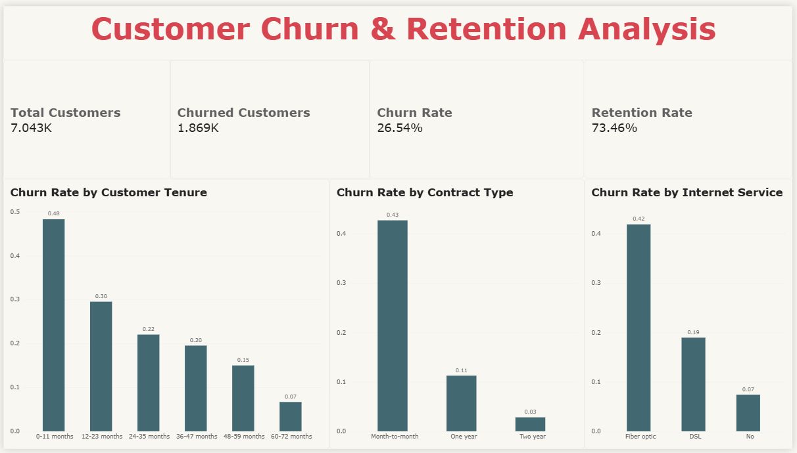

Dashboard: Executive Overview
26.54%
PORTFOLIO CHURN BENCHMARK
•
Tenure Decay: Churn spikes at 48% in months 0–11 and drops monotonically to only 7% by year five (60–72 months).
•
Commitment Leverage: Month-to-month contracts account for 43% attrition vs. 3% for two-year contracts.
•
Service Vulnerability: Fiber optic users demonstrate 42% churn, more than double DSL's 19%.

Slide 8
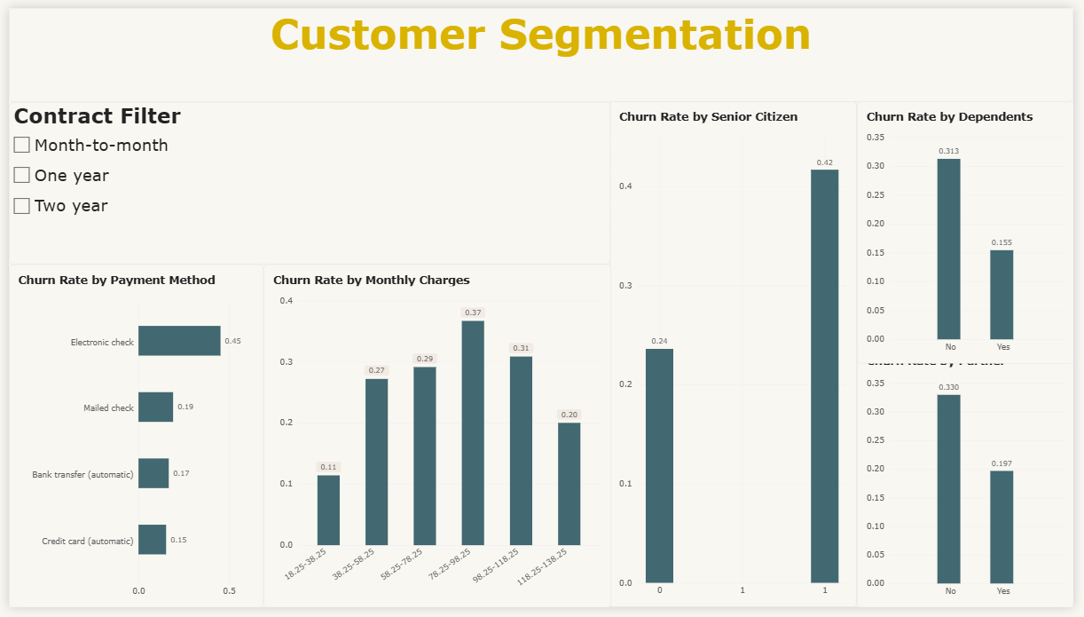
Dashboard: Customer Segmentation
45.0%
ELECTRONIC CHECK CHURN
•
Payment Friction: Electronic check churn (45%) vastly outpaces automated bank transfers (17%) and credit cards (15%).
•
Monthly Charge Curve: Churn climbs steeply from $18–$38 (11%) to peak in the $78–$98 tier (37%).
•
Demographics: Senior citizens display 42% churn vs. 24% for non-seniors; accounts without dependents churn at 31% vs. 15%.

Slide 9
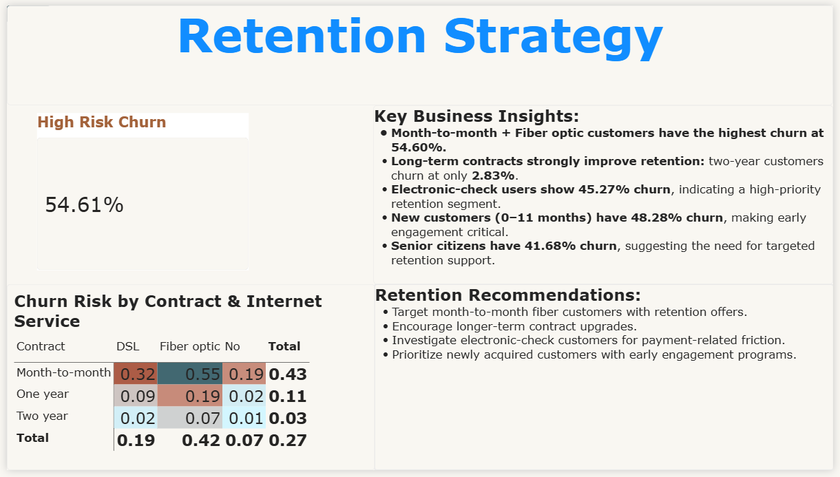

Dashboard: Retention Strategy
54.61%
CRITICAL RISK SEGMENT
•
High-Risk Nucleus: Month-to-month subscribers with Fiber optic service represent the primary loss driver.
•
Multi-Factor Risk: Month-to-month contracts combined with fiber-optic service show substantially elevated churn.
•
Immediate Focus: Prioritize this segment because it has the highest observed churn rate at 54.60%.

Slide 10





Actionable Retention Strategy
Contract Incentives
Auto-Pay Migration
Early-Tenure Retention
Offer targeted discounts and bundled value additions to transition high-risk month-to-month fiber subscribers onto 1- or 2-year commitments.
Offer targeted incentives to electronic-check users to encourage migration toward automated payment methods.
Strengthen onboarding, engagement and proactive support during the first 11 months of customer tenure.

Slide 11

Project Conclusion & Value
Analytical Synthesis
Strategic Business Impact
The transition from raw relational records to multi-layered business intelligence produced distinct operational advantages:
Implementation of targeted playbooks can help focus retention efforts on high-risk customer segments:
→
Demystified top-level 26.54% churn into identifiable, high-risk micro-cohorts.
→
Supports more targeted retention spending by prioritizing verified high-risk customer segments.
→
Found that tenure and contract duration are important dimensions for customer-retention segmentation.
→
Optimizes campaign budget allocation toward verified at-risk customer segments.
→
Equipped leadership with self-service slicing tools for continuous portfolio monitoring.
→
Provides an extensible reporting framework ready for machine learning predictive modeling.

Slide 12
Thank You
Questions, feedback, and discussion are welcome.
Mohit Bhilala
IIT Kharagpur
github.com/mohitbhilala005/Customer-Churn-Analysis

